Slide 1
Advance Internship@Clevered AI App/ Project Name
App User Manual
Author: Twisha Choudhary

Slide 2
Acknowledgements
I would like to express my sincere thanks and gratitude to Mr. Ken, my mentor Ms. Pratibha, and the entire Clevered team for helping me in my journey towards App Development. I was successfully able to make a working ‘Face Emotion Detector’ thanks to the support and guidance of my parents and my mentors . Thank you so much!

Slide 3
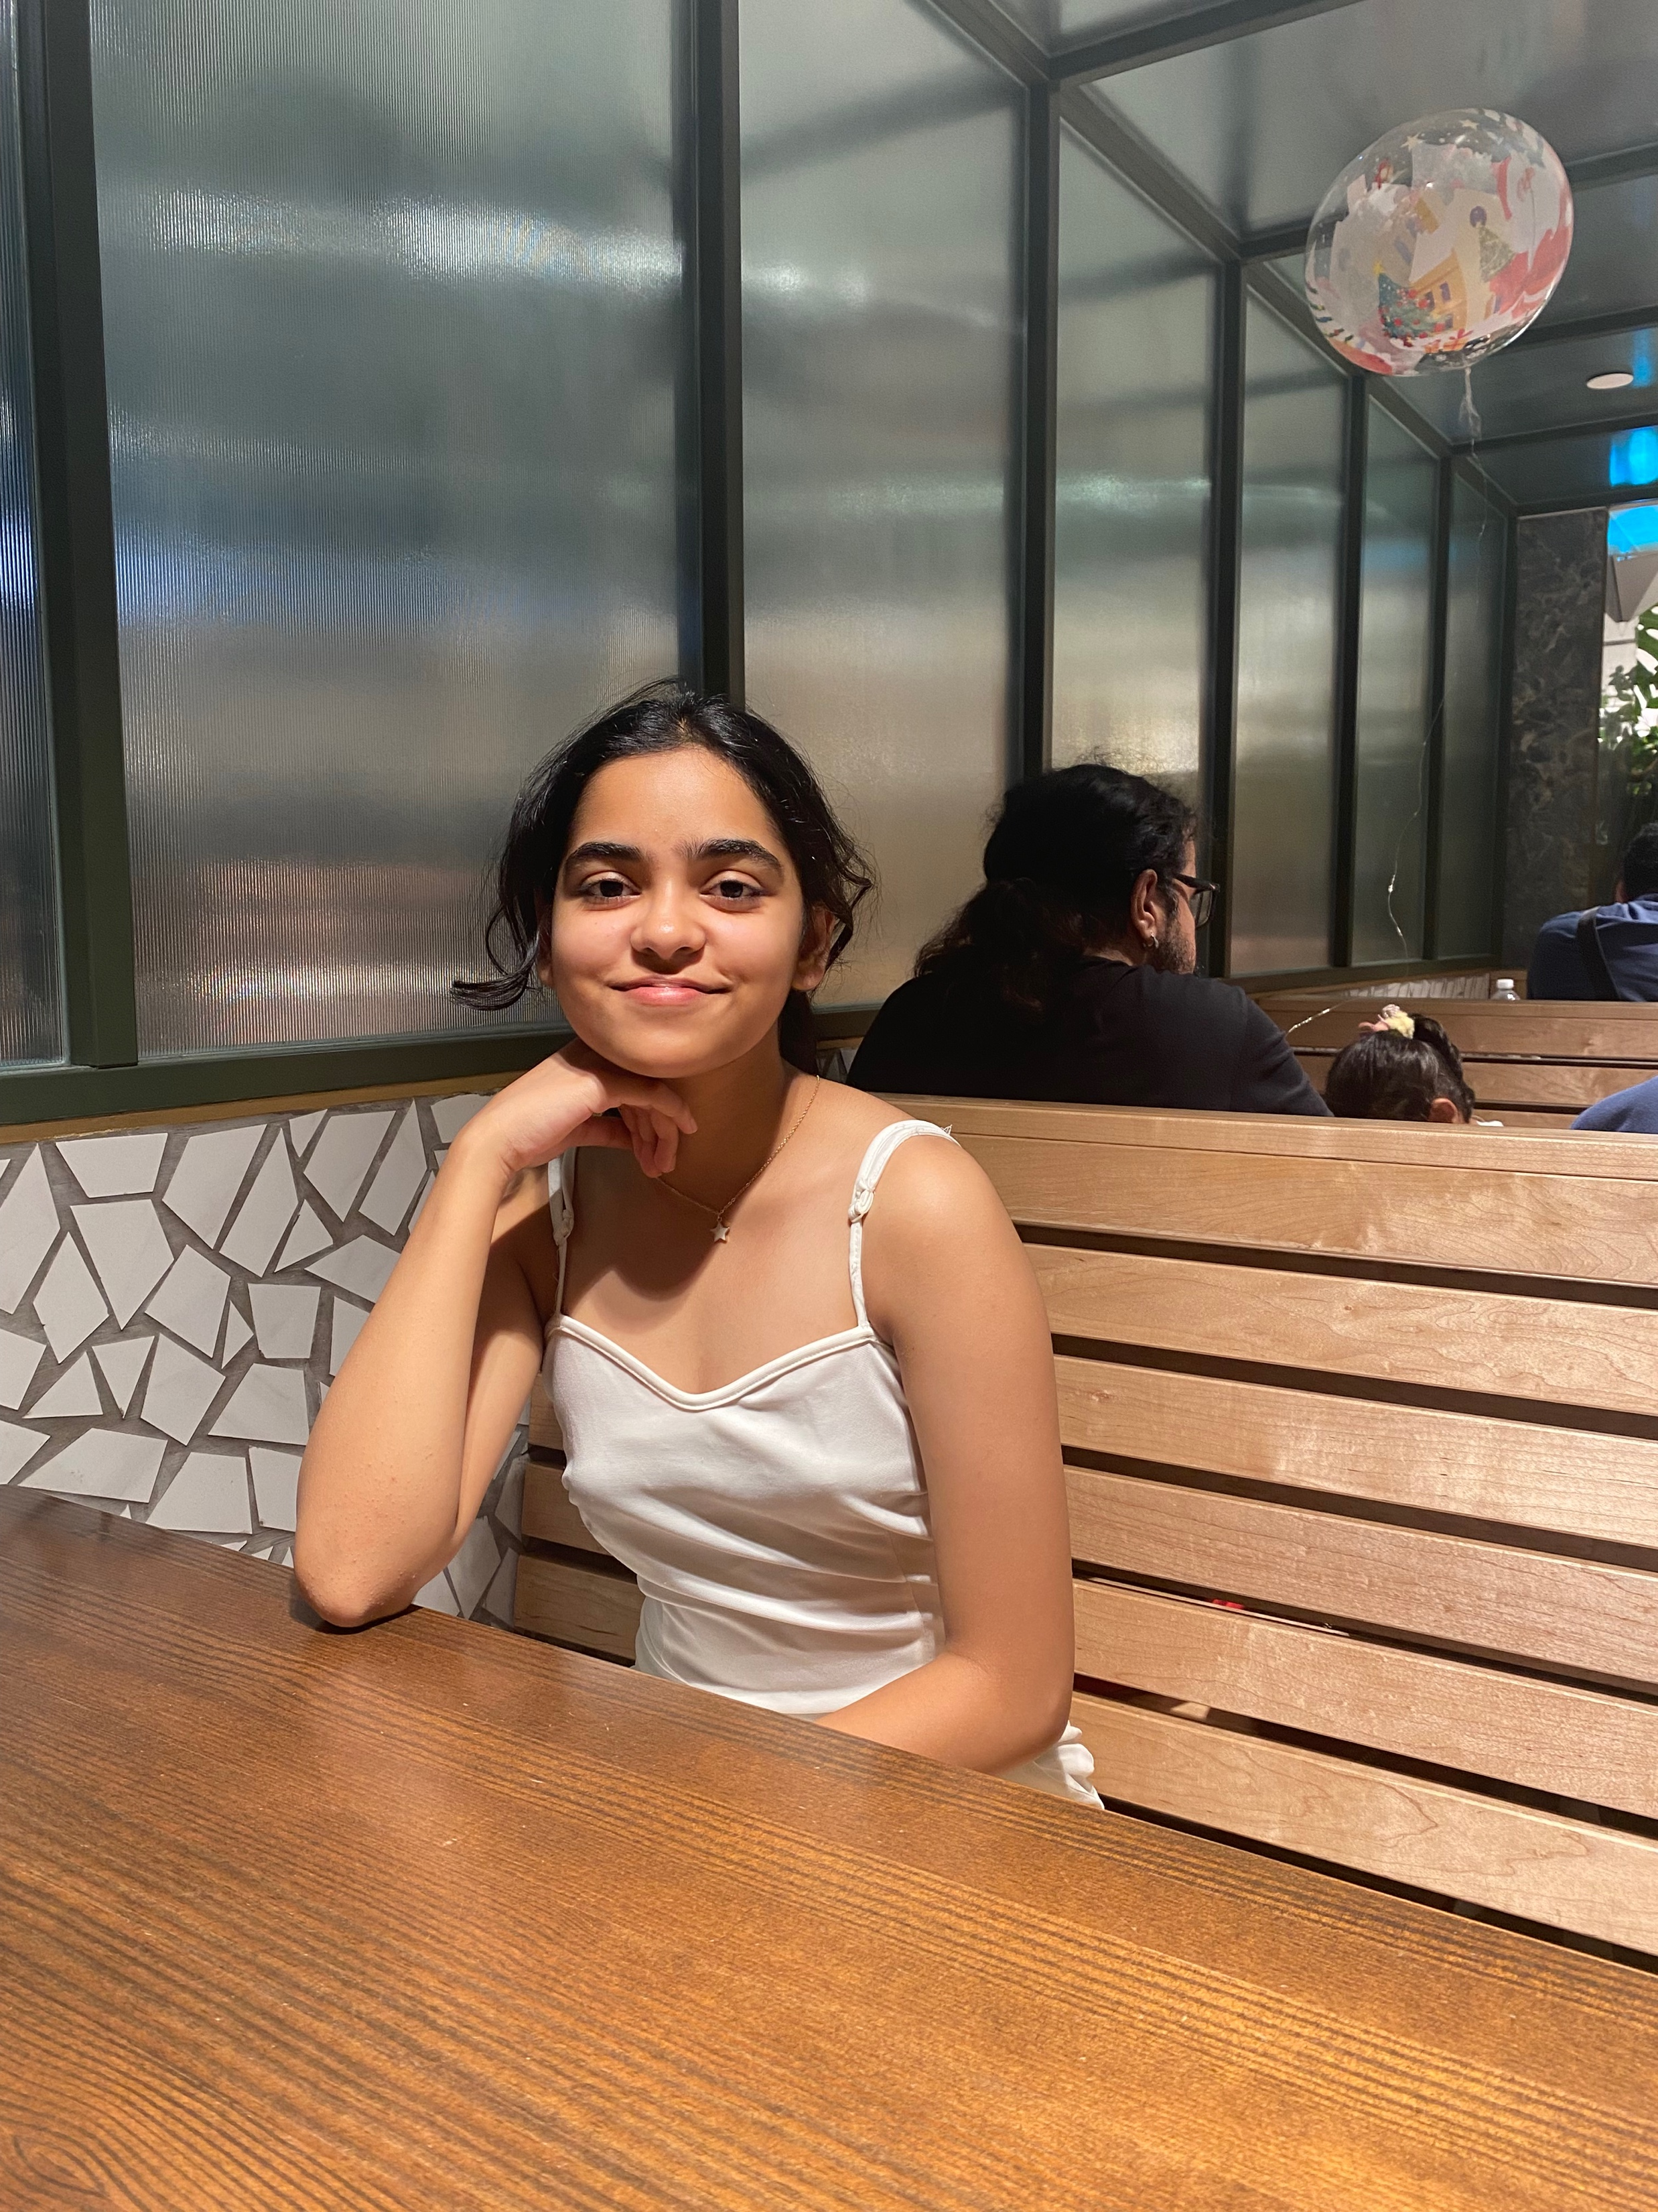
About Me..
I am an 11th grader currently studying at Welham Girls’ School, Dehradun. I am deeply passionate about coding and machine learning and hence wanted to work on this emotion recognition model as the first step towards successful app development.

Slide 4
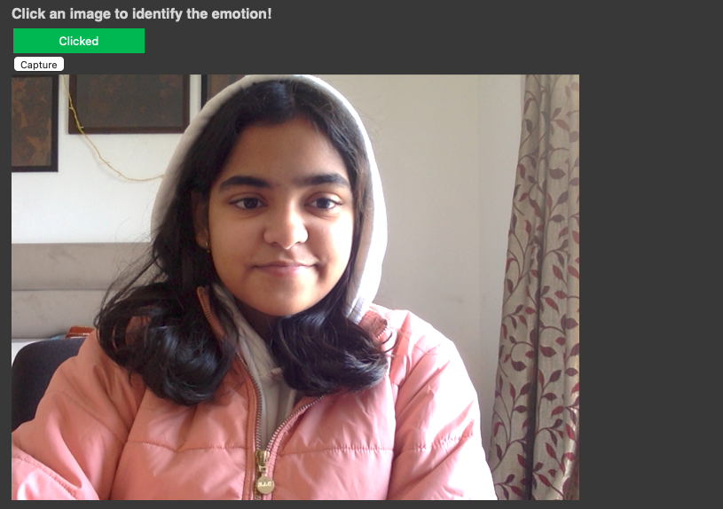
About My Internship with Clevered..
Any photographs from sessions etc.
I deeply enjoyed my internship with Clevered. I learnt many new things and worked on a project which will deeply help me accomplish my goals in the future. I worked with a new language and learned so much!

Slide 5
About App..
Header
Sub header
Click image button
Capture button
Detected emotion with image
My app is a working face emotion detector model. First the user has to click a picture of his/her face. The image is saved and then the code runs and the image is displayed with the dominant emotion on the top left corner.

Slide 6
How do I use the App?

Slide 7
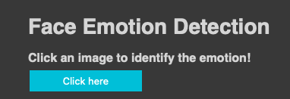
Click here
Click the button to start. Your device will ask for permission to allow camera access. Click allow.

Slide 8
Capture
Capture option will appear and your camera will turn on. Make sure that your face in the centre and that there are no disturbances in the background. Then click capture.

Slide 9
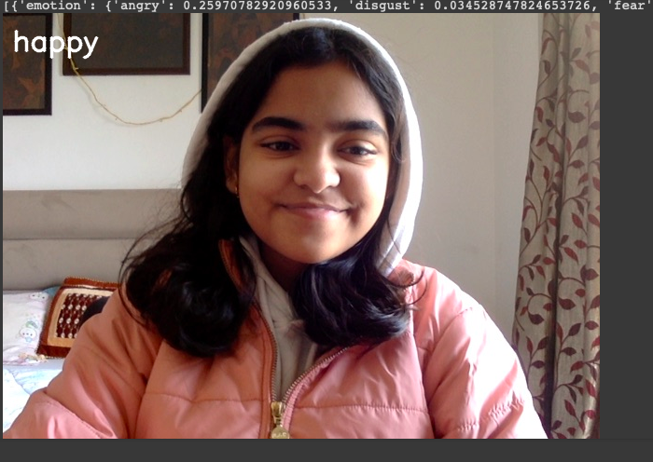
Capture
Your dominant emotion will be displayed on the top left corner!

Slide 10
Contact Person
Please reach out to Twisha Choudhary at twishac188@gmail.com for any questions/ concerns/ suggestions on the App

Slide 11
Thank you!

